Slide 1






Climate Change Prediction
Project Title
Team Members:
Anamika kumari
Minakshi Tripathi
Guide:
Karan Bhat
Disclaimer: The content is curated for educational purposes only.

Slide 2
OUTLINE
Climate Change Prediction
Abstract
Problem Statement
Aims, Objective & Proposed System/Solution
System Design/Architecture
System Development Approach (Technology Used)
Algorithm & Deployment
Conclusion
Future Scope
References
Video of the Project

Slide 3
Abstract This project employs advanced data analytics and machine learning to predict climate change impacts. By analyzing diverse datasets encompassing climate, atmospheric, oceanic, and socio-economic variables, we aim to develop accurate predictive models. Key stages include data preprocessing, feature engineering, model development, and validation. Through scenario analysis and uncertainty quantification, we assess future trajectories and associated risks. Our findings facilitate informed decision-making and policy formulation to mitigate climate change effects. Effective communication strategies ensure widespread dissemination of results, fostering collaboration and action. This project contributes crucial insights to address the urgent challenges posed by climate change.
Climate Change Prediction

Slide 4
Problem Statement Climate change poses significant threats to the environment, ecosystems, economies, and human health. Some key problems include: 1. Rising Temperatures 2. Extreme Weather Events 3. Sea Level Rise 4. Biodiversity Loss 5. Ocean Acidification
Climate Change Prediction

Slide 5
Aim and Objective
Climate Change Prediction
Forecasting Accuracy
Risk Assessment
Adaptation Planning
Mitigation Strategies
Decision Support
Public Awareness

Slide 6
Proposed Solution
Developed AI- ML based prediction algorithm.
Employ advanced data analytics techniques, such as machine learning algorithms, to identify patterns, trends, and correlations within the data.
Implement user-friendly interface for easy navigation.
Provide real-time updates on Climate.
Continuously refine and validate models using observed data and real-world events to enhance accuracy and reliability.

Slide 7









Software Requirement
Climate Change Prediction

Slide 8
Conclusion In closing, climate change prediction is our window into the future, offering invaluable foresight into the impacts of a changing climate. By embracing these predictions, we can chart a course towards sustainable solutions, resilience, and collective action. Let's harness the power of climate foresight to build a safer, healthier, and more prosperous world for everyone.
Climate Change Prediction

Slide 9
Future Scope Community and Societal Impacts: Climate change predictions will directly affect communities and societies worldwide. Anticipated changes in temperature, precipitation patterns, sea levels, and extreme weather events will impact agriculture, water resources, ecosystems, human health, and socio-economic systems. Vulnerable populations, including low-income communities and marginalized groups, are likely to bear the brunt of these impacts. Adaptive Strategies: Future climate change predictions will inform adaptive strategies aimed at reducing vulnerability and increasing resilience to climate impacts. These strategies may include infrastructure upgrades, land-use planning, ecosystem restoration, public health interventions, and social safety nets designed to protect vulnerable populations.
Climate Change Prediction

Slide 10
Climate Change Prediction
Reference
http://www.oreilly.com/data/free/the-new-artificial-intelligence-market.csp

Slide 11
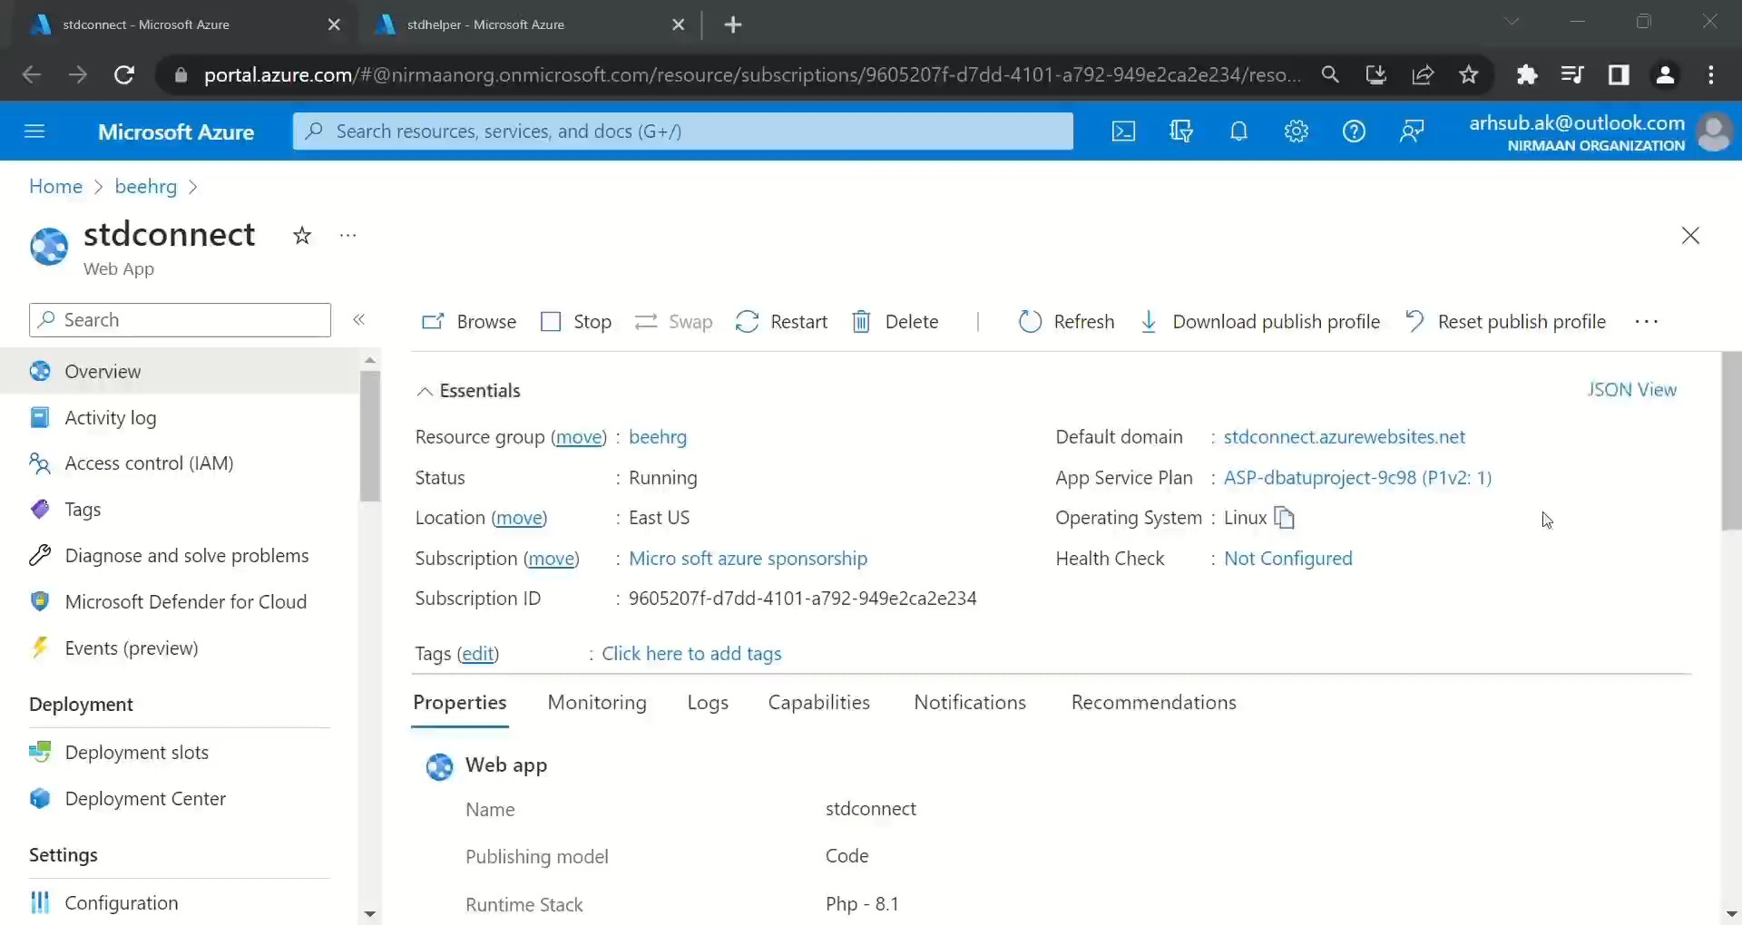
Climate Change Prediction

Slide 12
Thank you!
Climate Change Prediction

